Slide 1

MAJOR PROJECT ON
“TRAFFIC MONITORING ANALYSIS”
Submitted by
Guided by
ROKIBUL ISLAM RONI
Enrollment : XXXXXXXXX
Program : XXXXXXXXXXXXXX
Batch : XXXX-XX
MR. ANUJ GUPTA
XXXXXXXXXXXXXXXXX
XXXXXXXXXX

Slide 2
SHORT OVERVIEW
“TRAFFIC MONITORING”
01
04
Introduction
Architectural Design
02
05
Objective
Block Diagram
03
06
Feasibility Study
Flow Chart

Slide 3
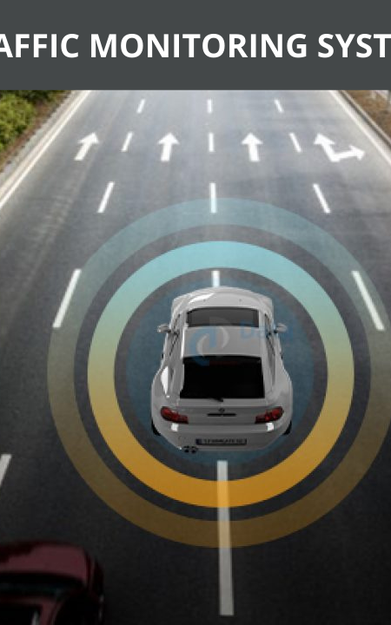
TRAFFIC MONITORING SYSTEM
Introduction!
Traffic Monitoring Analysis is an advanced Machine Learning Technology. It monitors vehicles speed, display the data and alert the driver at the real time by an android app.
The key processing steps involved in the Traffic Monitoring Systems which extracting the features of images in video frames and classifying them using trained component classifiers to determine the class of the object.

Slide 4
Objective
“TRAFFIC MONITORING”
Vehicle Detection
Being able to locate and identify
vehicles in a video sequence
Speed
Detection
Detecting the speed of the identified
vehicles (km/hr) in a video sequence
Notification
Get alert

Slide 5
Feasibility Study
“TRAFFIC MONITORING”
Risk Free to apply the technology.
Detect Speed any Vehicles
Easy to Monitor any Vehicles
Secured & Safe
Easy to Detect any Vehicles
Accurate with zero bugs

Slide 6
OBJECT DETECTION
“TRAFFIC MONITORING”
object (mm) =
focal length (mm) X real height of the object (mm) X
image height (pixels)
X sensor height (mm)
object height (pixels)

Slide 7
Hardware Requirements
“TRAFFIC MONITORING”
DISK: 100GB Enough for testing.
RAM: 4GB (Min)
PROCESSOR: Corei7 - 3.40 GHz.

Slide 8
Library & Tools Requirements
“TRAFFIC MONITORING”
Cv2
dlib
threading
numpy
math
cmake

Slide 9

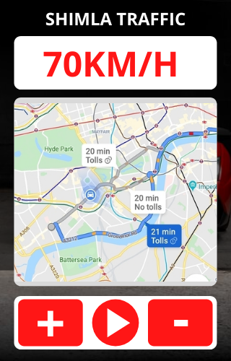





Architectural Design
“TRAFFIC MONITORING”
LIVE SPEED
71km/h
60km/h
TRAFFIC ALLERT
CURRENT LOCATION MAP
80km/h
65km/h
68km/h

Slide 10
Block Diagram
“TRAFFIC MONITORING”
DATABASE TRAINED
CAMERA SENSORE
DETECT SHAPE
OBJECT IDENTIFY
DETECT SPEED PER FRAME
TRAFFIC MONITORING MODEL
RESULT DISPLAY

Slide 11
Flow Chart
“TRAFFIC MONITORING”
START
Pre-Processing
Traffic Monitoring Model
Check Bugs?
INPUT VIDEO FRAME to IMG
OUTPUT
Check Bugs?

Slide 12
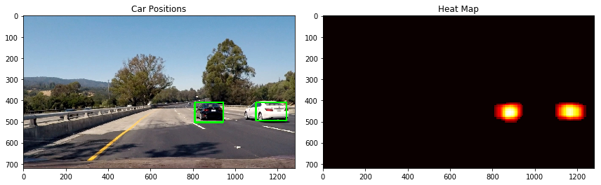
WORKING MODE
“TRAFFIC MONITORING”
HEAT MAP
HEAT MAP
DETECTION

Slide 13
Thank
You!

